Slide 1
Sign Language Detection
1.Rajesh Karumanchi
2.Chandra teja Kommineni

Slide 2
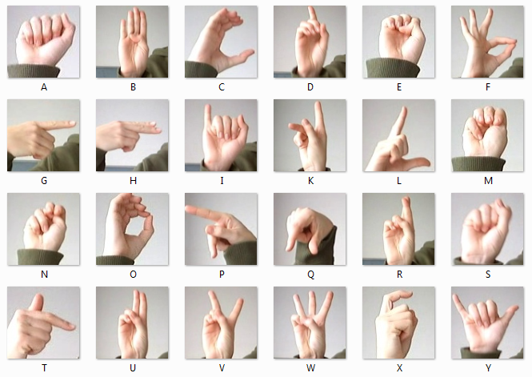
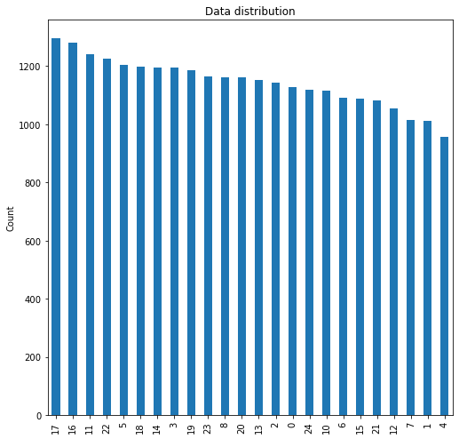
INTRODUCTION: Conversing with people having a hearing disability is a major challenge. Deaf and Mute people use hand gesture sign language to communicate, hence normal people face problems in recognizing their language by signs made. Hence there is a need for systems that recognize the different signs and conveys the information to normal people.
Dataset:
We obtained the dataset from Kaggle https://www.kaggle.com/datasets/datamunge/sign-language-mnist
Each training and test case represents a label (0-25) as a one-to-one map for each alphabetic letter A-Z (and no cases for 9=J or 25=Z because of gesture motions).
Train, test data sets are of shape (27455, 785) & ( 7172,785) (28*28 pixel size image + Label)
From https://www.kaggle.com/datasets/datamunge/sign-language-mnist

Slide 3
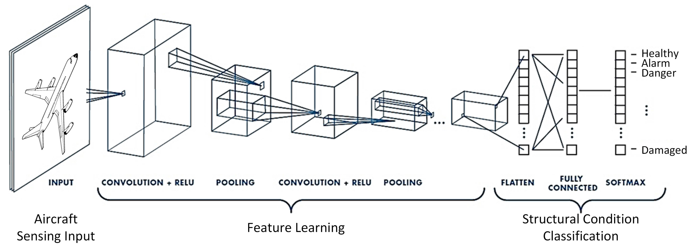
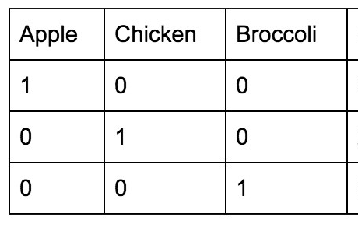
Why CNN?
Python Packages used
Pandas
Numpy
Matplotlib
Keras models and layers API’s
Preprocessing steps:
1.Normaliztion : X_{N =} (X – X_{min})/(X_{max} – X_{min})
2. One hot encoding :
Initially, we created 3 CNN based deep learning models
Epochs = 10
Batch_size = 128
215 batches in each epoch
https://www.mdpi.com/1424-8220/19/22/4933
Sparse connectivity : Single element in feature map connected to small patch of elements
Parameter Sharing : Same weights used for different patches of input images
Many layers : Combining extracted local patterns to global patterns

Slide 4
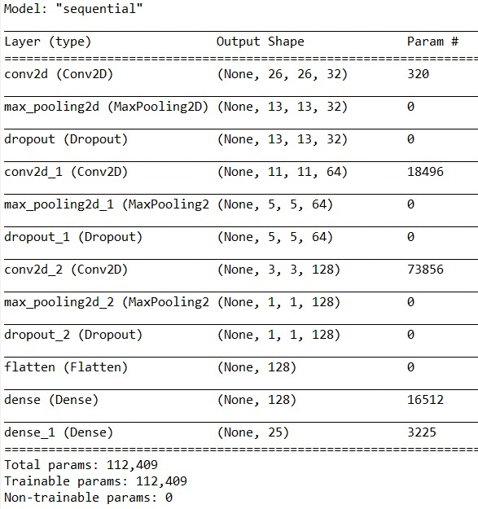
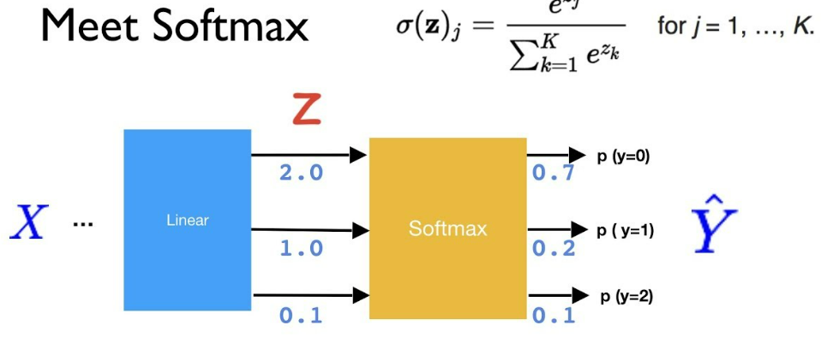
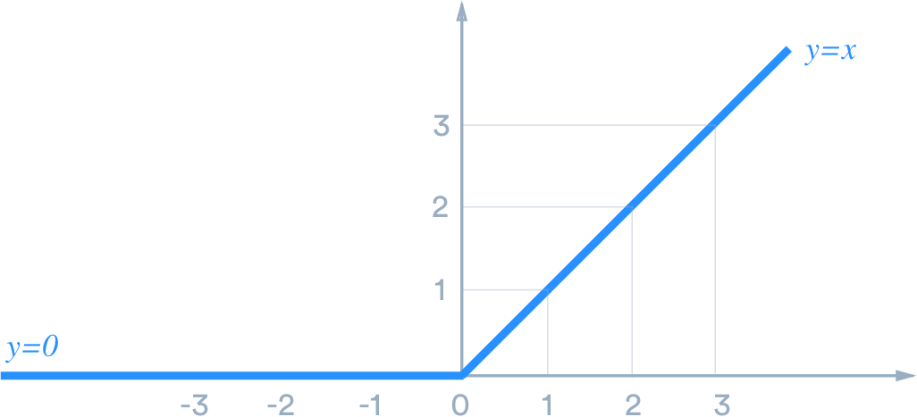
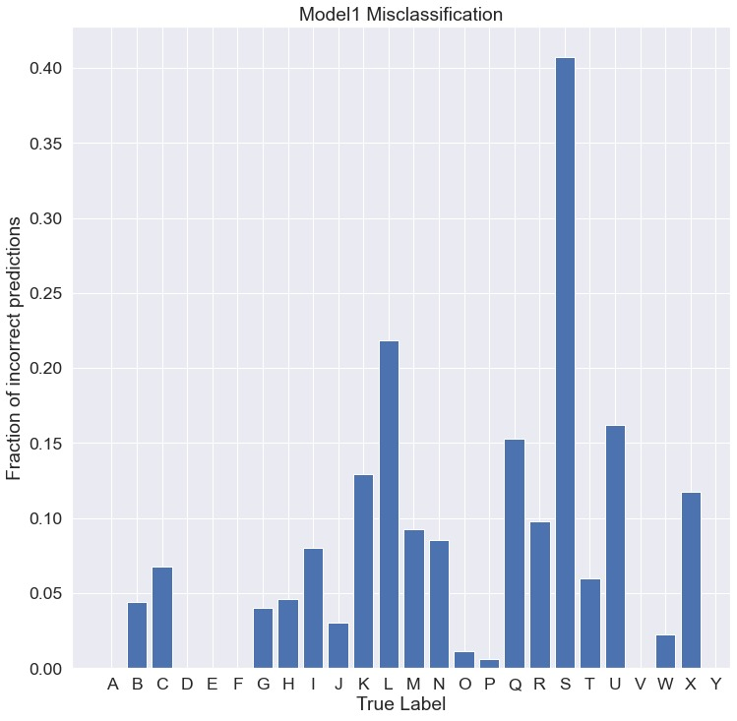
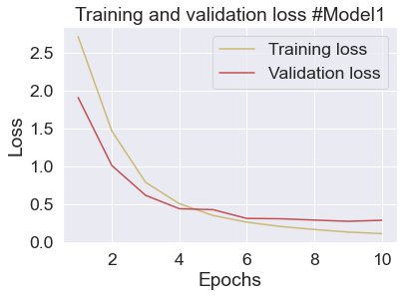
Overview of the CNN based model 1
Softmax Classifier:
ReLu

Slide 5
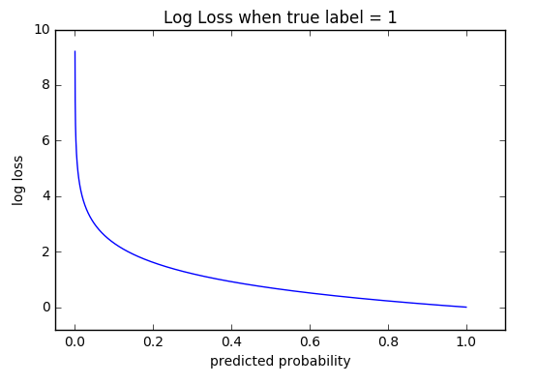
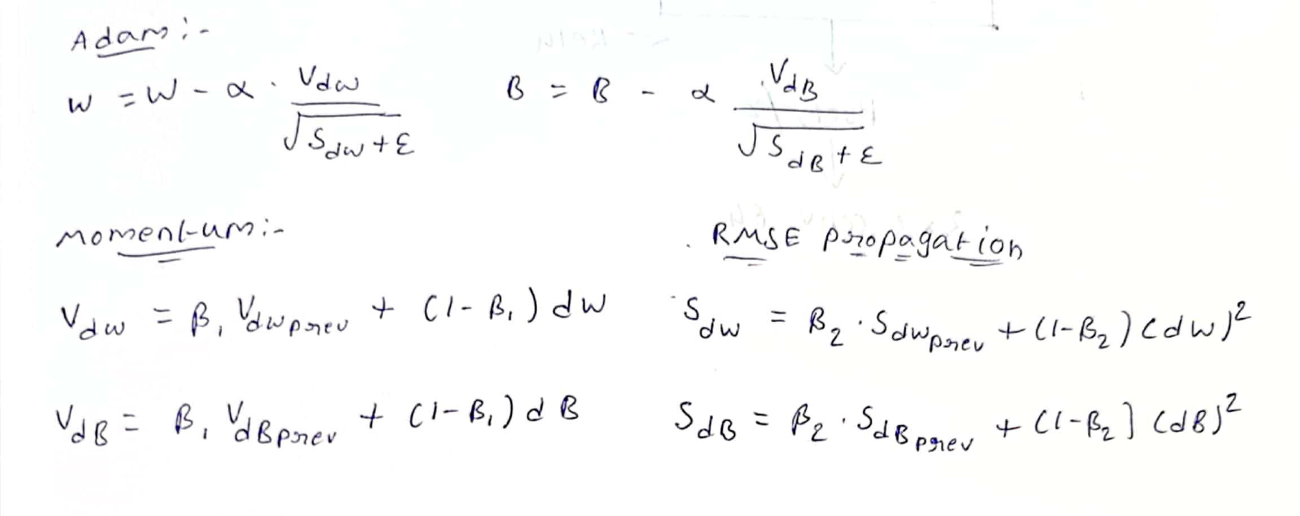
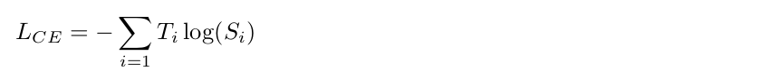
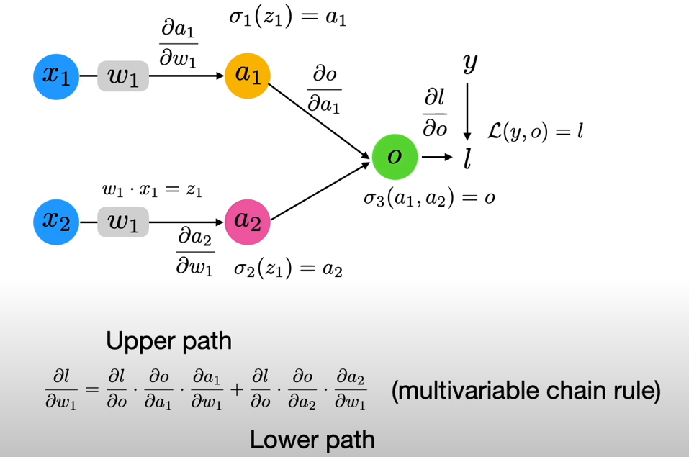
Optimizer: (Adam Optimizer)
BACK PROPAGATION FOR CNN
- dw = derivative of Loss wrst weight W
- dB = derivative of Loss wrst to Bias B
- S_{dw} = sum of squares of past gradients
- V_{dw} = aggregate of gradients (initialise S and V as ‘0’ and update iteratively
- β_{1,} β₂ = Moving average parameters (β₁ = 0.9,β₂ = 0.999)
- e = 10⁻⁸

Slide 6
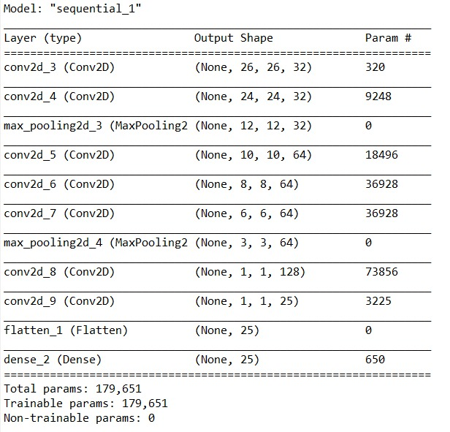
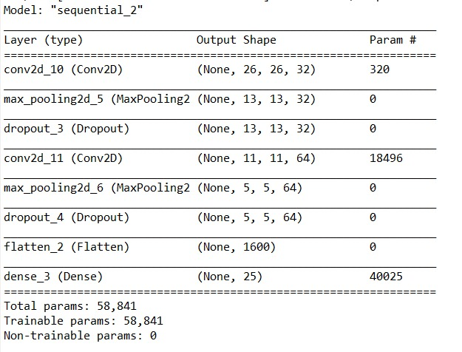
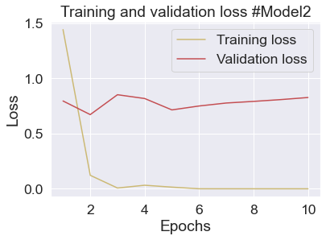
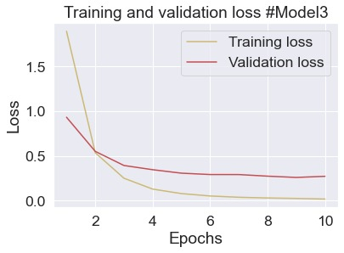
Model - 2
Model - 3
Accuracy :
Accuracy :

Slide 7
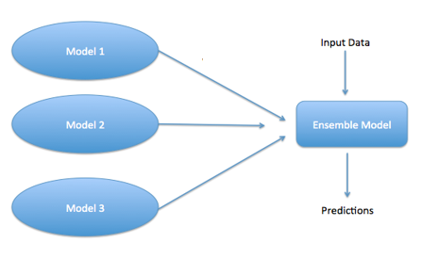
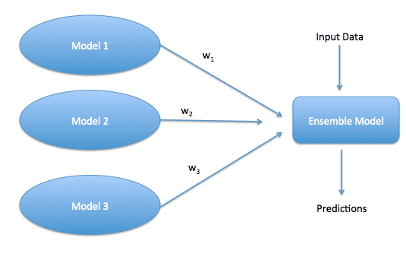
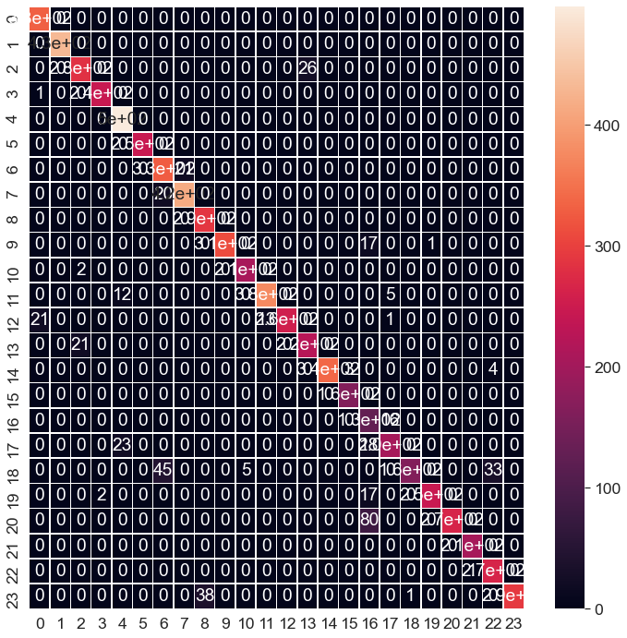
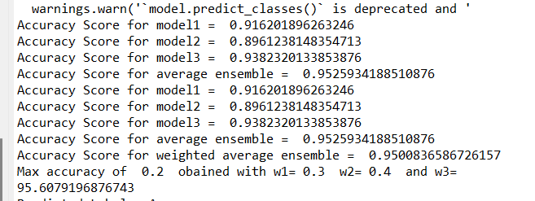
Robustness: - It also limits the spread or dispersion of model forecasts and performance. Performance: -Ensemble can make better forecasts and deliver better results than any single component model. An ensemble can create lower variance and lower bias
Ensemble approach
Average Ensemble
Weighted Ensemble
E1 = argmax(sum across classes)
Accuracy = 95.66% Val_acc = 93.44%
E2 = argmax(weighted sum across classes)
Accuracy = 96.77% Val_acc = 95.44%
Confusion Matrix:
Accuracy scores on test data:

Slide 8
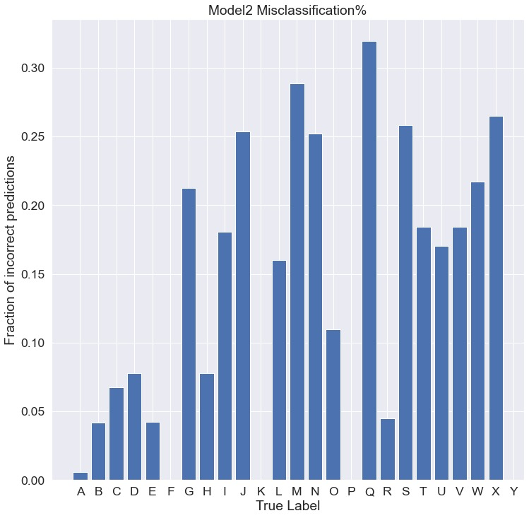
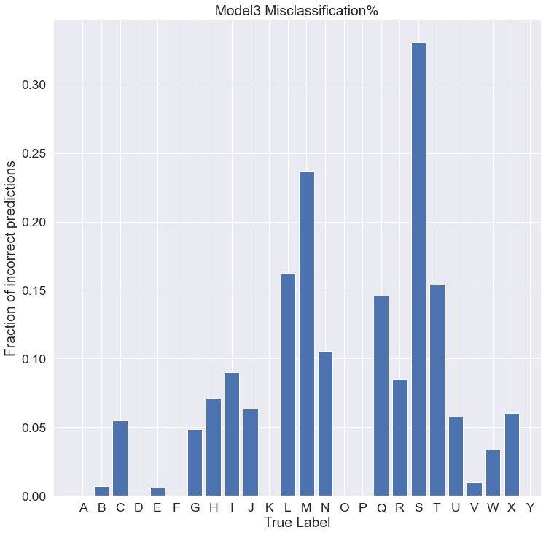
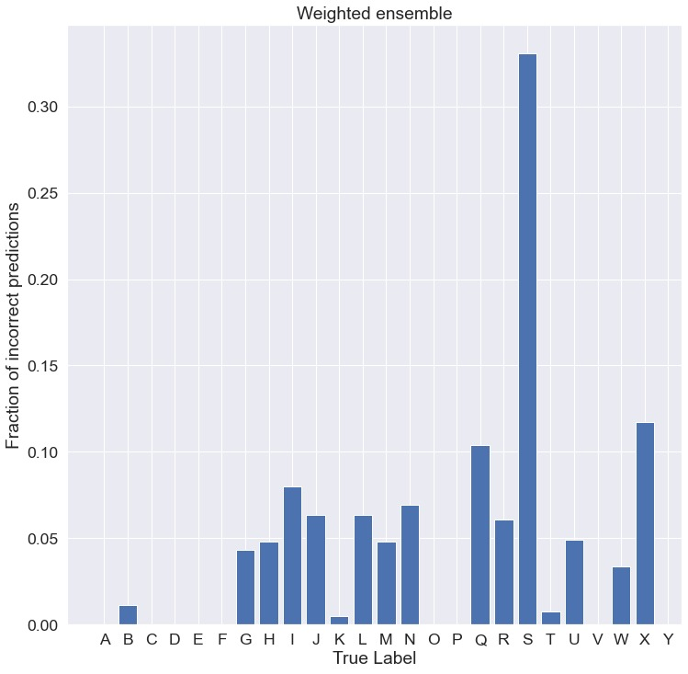

Slide 9
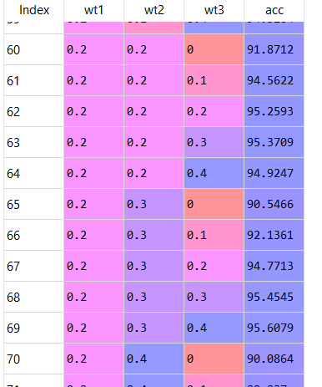
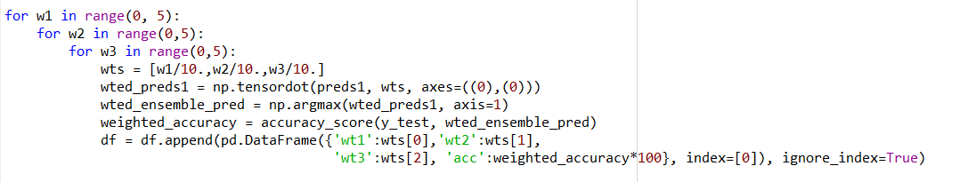
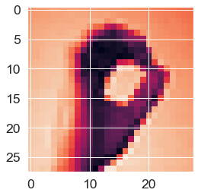
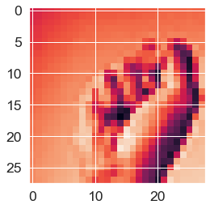
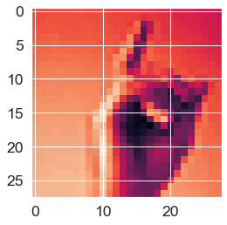



Grid search
Results:

Slide 10
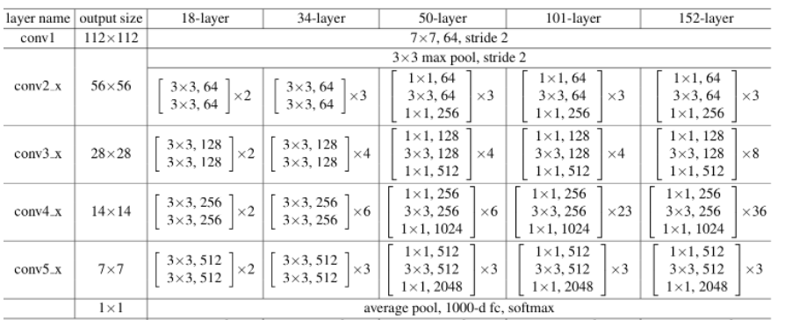
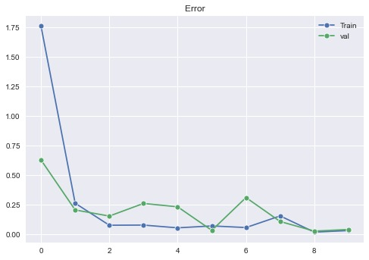
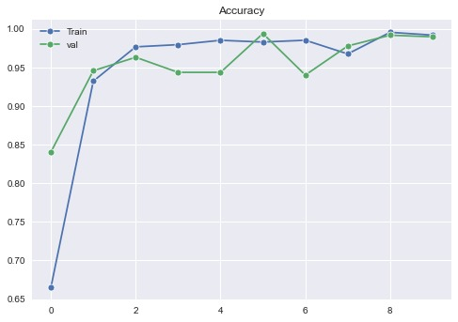
RESNET
Handling the vanishing gradient problem in very deep CNNs
accuracy: 0.9917
Val loss: 0.0379
Val accuracy: 0.9895

